Slide 1
Graph Theory
Euler Paths & Cycles
By Thomas Ng and Chavisa Arpavoraruth

Slide 2
So….
what is a graph actually?
Notes:
A graph is a collection of ‘vertices’ and ‘edges’. There are three examples above in black. Where might we see a graph in our every day lives? (Hint: look to the right picture!)

Slide 3
Drawing graphs in a single stroke
Notes:
Can you draw the graph on the left without picking up your pencil?

Slide 4
Exercise 1:
Now, your turn!
Work as a group of 2-3 people
Each group will be given one diagram to solve Exercise 1 from the worksheet
Group 1
Group 2
Group 3
Group 4
Notes:
See attached worksheet of exercises. You can also do this exercise individually if you are exploring this activity after the program!

Slide 5
What did you find?
1
1
4
1
1
2
4
5
3
2
5
3
2
2
3
4
5
4
3
6

Slide 6
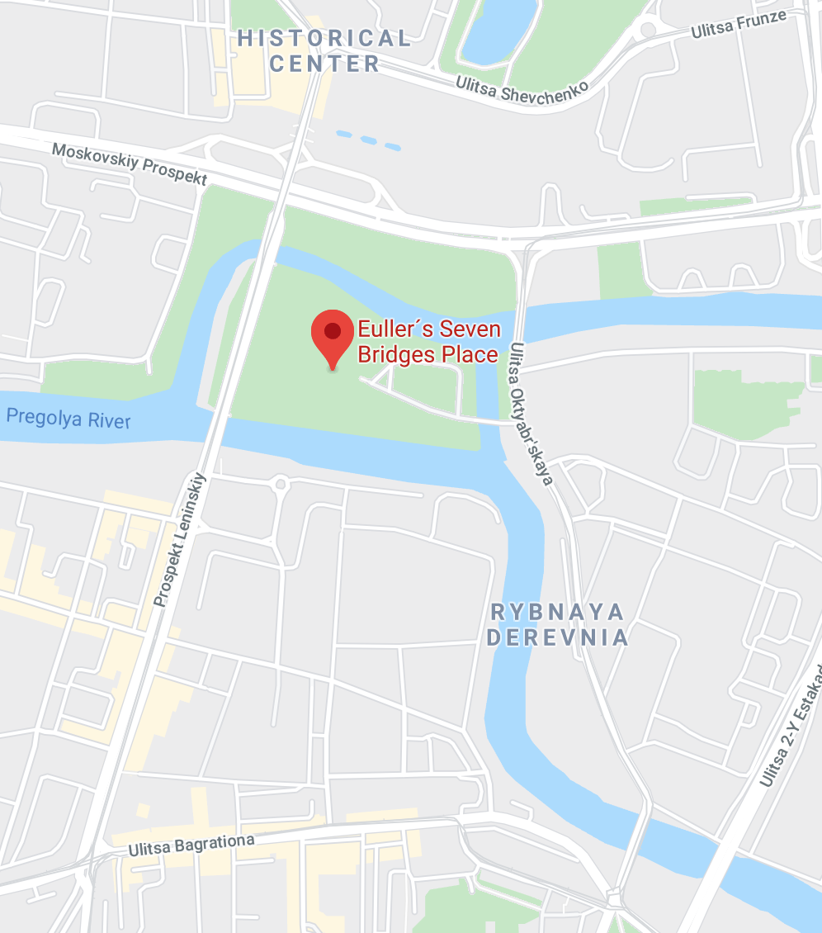
Story Time: Bridges of Königsberg
A
Question:
Is there a way to see the whole city and cross every bridge exactly once?
B
C
D

Slide 7
Can you solve this problem (with a graph)?
A
A
B
B
C
C
D
D
Notes:
Answer:
It doesn’t work. (Each vertex has a degree of 3)

Slide 8
Euler Paths and Cycles
Definition 1: An Euler path is a path that passes every edge without repeating the edge.
Definition 2: An Euler cycle is an Euler path that starts and ends on the same vertex.
A
B
C
D
Notes:
How do Euler paths/cycles answer the original problem?

Slide 9
Euler’s solution (1736)
Theorem 1: A connected graph contains an Euler cycle exactly when every vertex has even degree.
A
B
C
D

Slide 10
Euler’s solution (1736)
Theorem 1: A connected graph contains an Euler cycle exactly when every vertex has even degree.
Definition: The degree of a vertex is the number of edges that are attached to that vertex.
A
B
C
D

Slide 11
Euler’s solution (1736)
Theorem 1: A connected graph contains an Euler cycle exactly when every vertex has even degree.
Definition: The degree of a vertex is the number of edges that are attached to that vertex.
Question: Does this graph contain an Euler cycle?
A
B
C
D
Notes:
Answer: This graph does not contain an Euler cycle. Why?

Slide 12
Euler’s solution (1736)
Theorem 2: A connected graph contains an Euler path exactly when at most two vertices have odd degree.
Question: Does this graph contain an Euler path?
A
B
C
D
Notes:
Answer: This graph does not contain an Euler path

Slide 13
What changed? (2020)
A
A
A
X
B
B
C
B
C
C
X
D
D
D
Notes:
Suppose that two of the bridges are removed. Does the new graph have an Euler path or Euler cycle?
Answer: There is Euler path! (but there is no Euler cycle)

Slide 14
Exercise 2:
Do the following graphs contain an Euler cycle?
Group 1
Group 2
Group 3
Group 4
Notes:
See attached worksheet of exercises. You can also do this exercise individually if you are exploring this activity after the program!

Slide 15
Break time!
~~15 minutes~~

Slide 16
Exercise 3: Euler cycles in the real world
Discuss in group of 2-3 people about how Euler cycles can be used on the real world setting.
Notes:
If you are viewing this workshop after the program, go talk to a friend or family member about what you have learned!

Slide 17
Exercise 4:
Constructing Complicated Euler Cycles
Can you construct a connected graph with 6 vertices so that every vertex has degree 2 or 4 and at least one vertex with degree 4?
Notes:
See attached worksheet of exercises.

Slide 18
Combining Graphs (part 1)
Describe your graph to a partner so that they can draw it on their worksheet
Combine your two graphs both with repeated edges
+
→
Does the combined graph still contain an Euler cycle?

Slide 19
Combining Graphs (part 2)
Describe your graph to a partner so that they can draw it on their worksheet
Combine your two graphs both without repeated edges
+
→
Does the combined graph still contain an Euler cycle?

Slide 20
What did we learn today?
Great work today!

